Slide 1

Lecture 4: Adaptive Learning Rate and Classification
Hands on Artificial Intelligence and Robotics
Lingxiao Wang, Ph.D.
Assistant Professor of Electrical Engineering
Louisiana Tech University

Slide 2
Adaptive Learning Rate

Slide 3
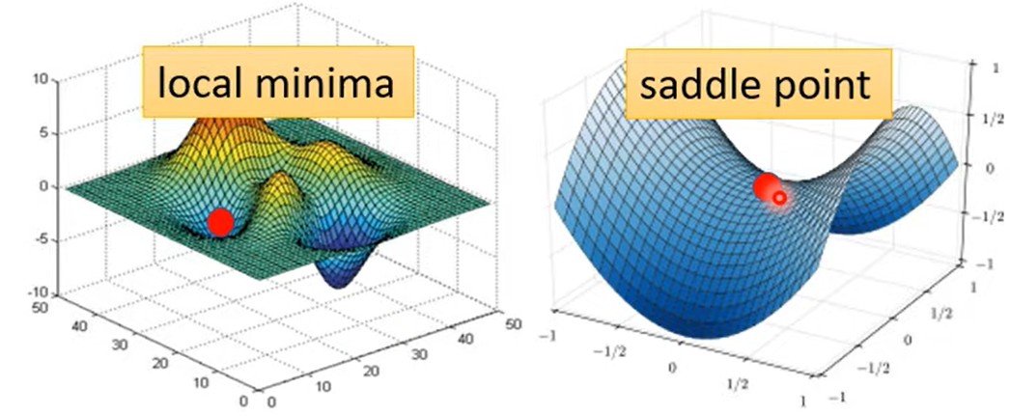
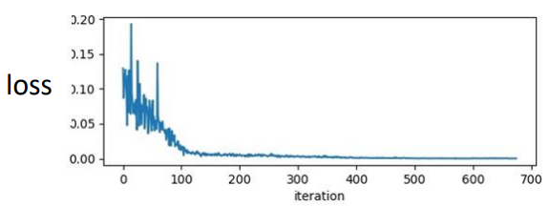
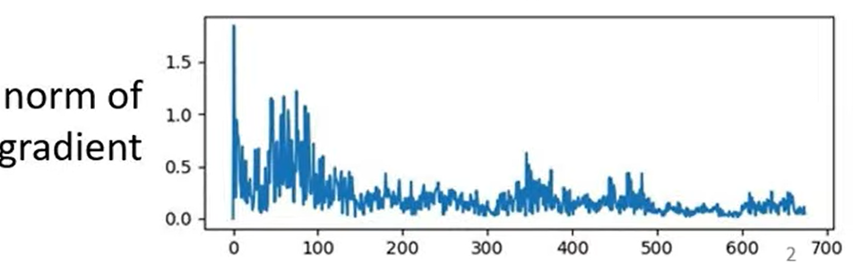

Review
In the previous lecture, we learn that at critical points (i.e., local minimal or saddle points), the gradient of loss equals to zero.
However, training stuck is not always due to critical points.
Critical points: When loss gradient equals to zero, we cannot optimize the loss function anymore -> training stuck.
The change of loss is small, is the gradient also small at this point?
The gradient norm (i.e., amplitude) is still large.
Training stuck $≠$ Small Gradient

Slide 4
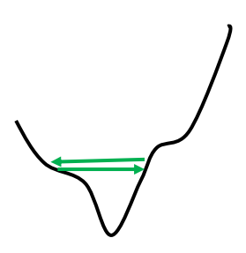
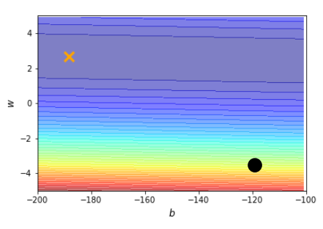
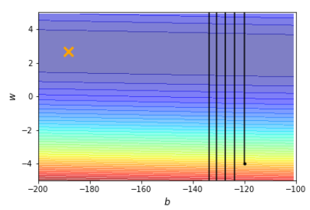
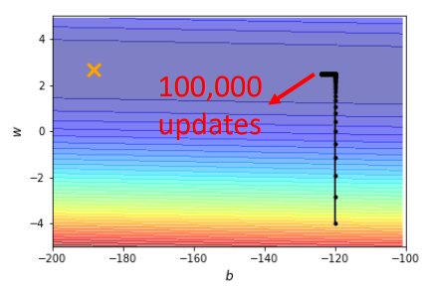

Training Stuck $≠$ Small Gradient
$$θ^{1}=θ^{0}−ηg^{0}$$
A possible reason for small loss change but large gradient norm:
This is because the learning rate is too large.
Adaptive learning rate:
Large update step at smooth loss surface.
Small update step at rough loss surface.
Here is another example on 2D loss surface
Loss Surface
Gradient Norm
Change Learning rate automatically
Optimal
Start
Always Large
Learning Rate
Always Small
Learning Rate

Slide 5
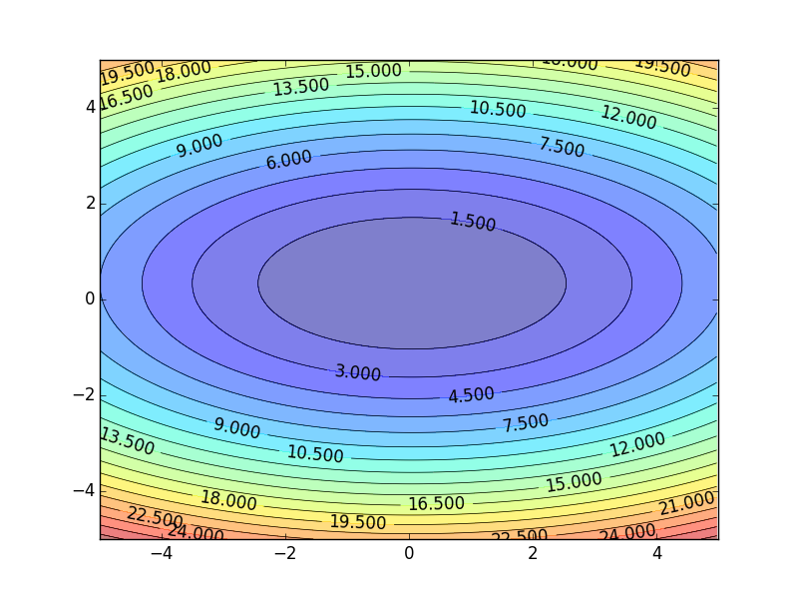
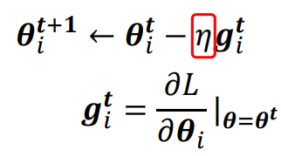
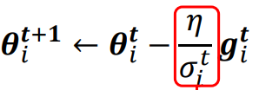




AdaGrad
Adaptive Learning Rate Algorithm: AdaGrad
Motivation:
Adaptively change learning rate for different types of loss surfaces.
Larger learning rate when loss surface is smooth.
Smaller learning rate when loss surface is rough.
Vanilla Gradient descent for one parameter $θ_{i}$:
Smaller Learning Rate
Fixed Learning Rate
$$w_{2}$$
Adaptive Learning Rate:
Larger Learning Rate
Adaptive Learning Rate
$σ_{i}^{t}$ changes it values for different $i$ and $t.$
$$w_{1}$$

Slide 6
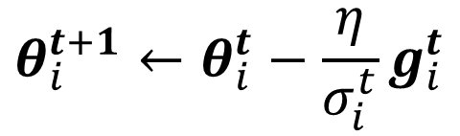
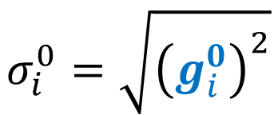
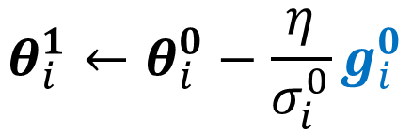

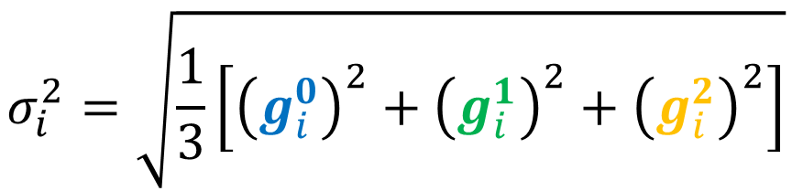
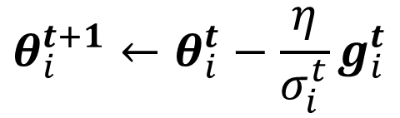
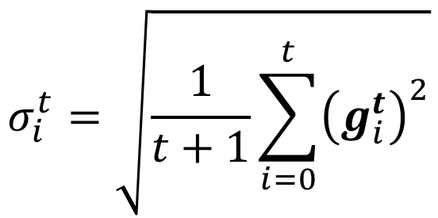
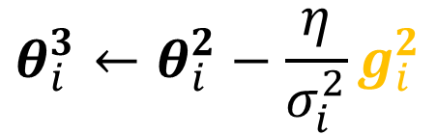
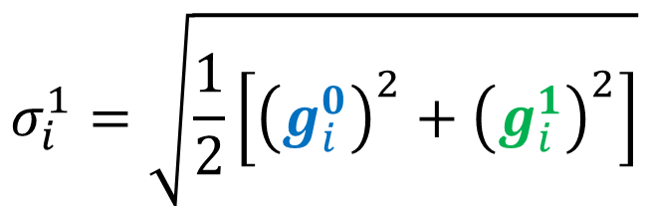
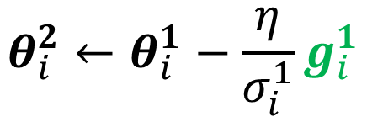
Root Mean Square
$$θ_{i}^{t+1}←θ_{i}^{t}−\frac{\text{η}}{σ_{i}^{t}}g_{i}^{t}$$
Adagrad defines $σ_{i}^{t}$ as Root Mean Square of previous gradients$.$
$$θ_{i}^{1}←θ_{i}^{0}−\frac{\text{η}}{σ_{i}^{0}}g_{i}^{0}$$
$$σ_{i}^{0}=\sqrt{{\left(g_{i}^{0}\right)}^{2}}$$
$$=\left|g_{i}^{0}\right|$$
$$σ_{i}^{1}=\sqrt{\frac{1}{2}\left[{\left(g_{i}^{0}\right)}^{2}+{\left(g_{i}^{1}\right)}^{2}\right]}$$
$$θ_{i}^{2}←θ_{i}^{1}−\frac{\text{η}}{σ_{i}^{1}}g_{i}^{1}$$
$$σ_{i}^{2}=\sqrt{\frac{1}{3}\left[{\left(g_{i}^{0}\right)}^{2}+{\left(g_{i}^{1}\right)}^{2}+{\left(g_{i}^{2}\right)}^{2}\right]}$$
$$θ_{i}^{3}←θ_{i}^{2}−\frac{\text{η}}{σ_{i}^{2}}g_{i}^{2}$$
……
$$σ_{i}^{t}=\sqrt{\frac{1}{t+1}\sum_{i=0}^{t}{{\left(g_{i}^{t}\right)}^{2}}}$$
$$θ_{i}^{t+1}←θ_{i}^{t}−\frac{\text{η}}{σ_{i}^{t}}g_{i}^{t}$$
Why does it work?
Notes:
Divide the learning rate of each parameter by the root mean square of its previous derivatives

Slide 7
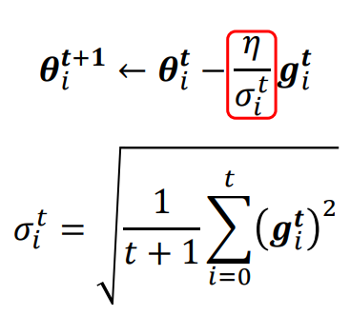
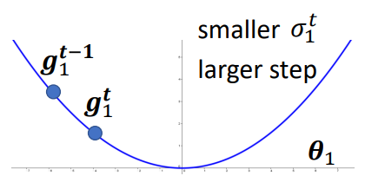
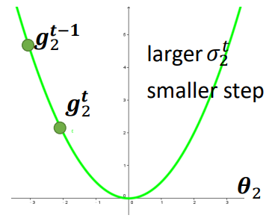
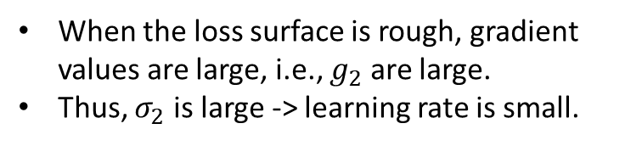
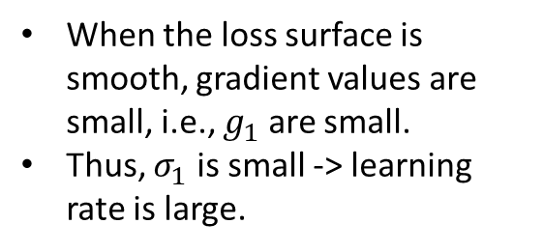
Why AdaGrad Works
AdaGrad can adaptively change the learning rate based on the situation of loss surface:
Large learning rate for smooth loss surface.
Small learning rate for rough loss surface.
Suppose that we have 1-D error surfaces for two parameters:
Smooth Surface
When the loss surface is smooth, gradient values are small, i.e., $g_{1}$ are small.
Thus, $σ_{1}$ is small -> learning rate is large.
Rough Surface
When the loss surface is rough, gradient values are large, i.e., $g_{2}$ are large.
Thus, $σ_{2}$ is large -> learning rate is small.

Slide 8









Improve AdaGrad: RMSProp
AdaGrad considers all the previous gradients, but
Recent gradient has larger impact, and the past gradient has less impact.
RMSProp is an impoved AdaGrad, which
Calculates the superposition of past gradient and the recent gradient.
$$θ_{i}^{1}←θ_{i}^{0}−\frac{\text{η}}{σ_{i}^{0}}g_{i}^{0}$$
$$σ_{i}^{0}=\sqrt{{\left(g_{i}^{0}\right)}^{2}}$$
$$θ_{i}^{2}←θ_{i}^{1}−\frac{\text{η}}{σ_{i}^{1}}g_{i}^{1}$$
$$σ_{i}^{1}=\sqrt{{α\left(σ_{i}^{0}\right)}^{2}+\left(1−α\right){\left(g_{i}^{1}\right)}^{2}}$$
$$0<α<1$$
Weight of the past gradient;
Hyper-parameter to tune.
$$θ_{i}^{3}←θ_{i}^{2}−\frac{\text{η}}{σ_{i}^{2}}g_{i}^{2}$$
$$σ_{i}^{2}=\sqrt{{α\left(σ_{i}^{1}\right)}^{2}+\left(1−α\right){\left(g_{i}^{2}\right)}^{2}}$$
……
$$θ_{i}^{t+1}←θ_{i}^{t}−\frac{\text{η}}{σ_{i}^{t}}g_{i}^{t}$$
$$σ_{i}^{t}=\sqrt{{α\left(σ_{i}^{t−1}\right)}^{2}+\left(1−α\right){\left(g_{i}^{t}\right)}^{2}}$$

Slide 9
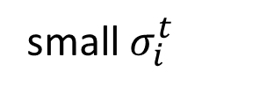
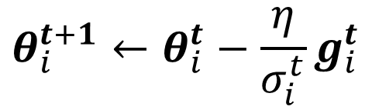

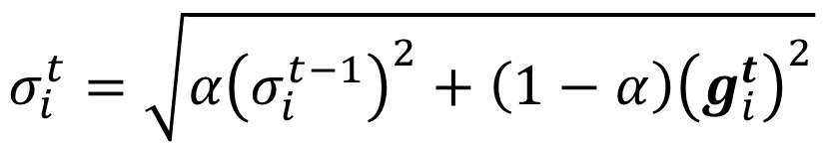

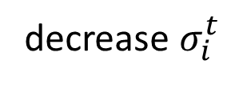

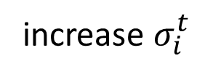

RMSProp
$$g_{i}^{1}$$
$$g_{i}^{2}$$
……
$$g_{i}^{t−1}$$
$$0<α<1$$
$$θ_{i}^{t+1}←θ_{i}^{t}−\frac{\text{η}}{σ_{i}^{t}}g_{i}^{t}$$
$$σ_{i}^{t}=\sqrt{{α\left(σ_{i}^{t−1}\right)}^{2}+\left(1−α\right){\left(g_{i}^{t}\right)}^{2}}$$
The recent gradient has larger influence, and the past gradients have less influence.
small $σ_{i}^{t}$
increase $σ_{i}^{t}$
larger step
smaller step
decrease $σ_{i}^{t}$
larger step
Notes:
Why square

Slide 10
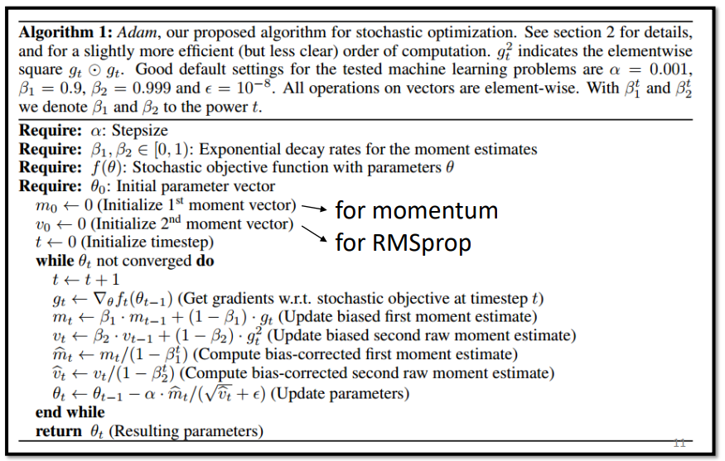
Adam: RMSProp + Momentum
Most Commonly-used Optimizer: Adam
RMSProp + Momentum
PyTorch encapsulates Adam in the optimization selection.

Slide 11
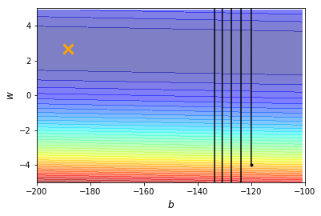
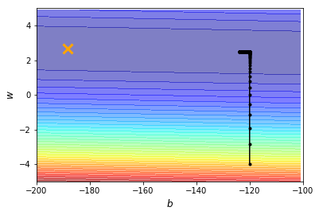
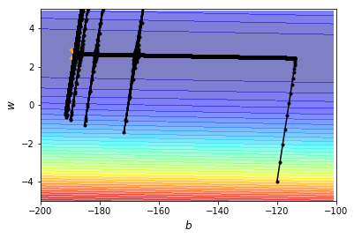
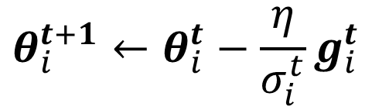
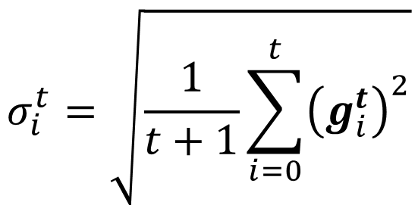
Without Adaptive Learning Rate
Why explosion?
$$θ_{i}^{t+1}←θ_{i}^{t}−\frac{\text{η}}{σ_{i}^{t}}g_{i}^{t}$$
$$σ_{i}^{t}=\sqrt{\frac{1}{t+1}\sum_{i=0}^{t}{{\left(g_{i}^{t}\right)}^{2}}}$$

Slide 12
Solution: Learning Rate Schedule
Small Gradient -> Large Step
Large Gradient -> Small Step
Large Gradient -> Small Step
Very Small Gradient accumulated on w direction -> Explosive Large Step on w direction

Slide 13
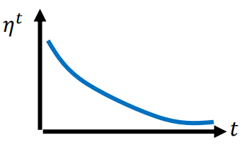
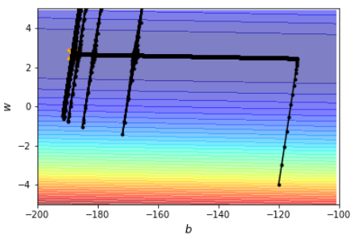
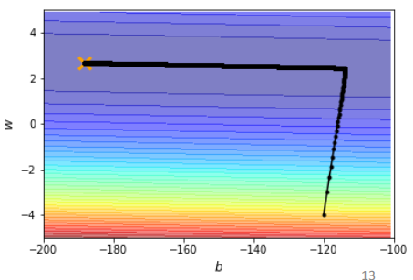
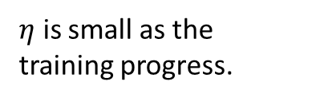

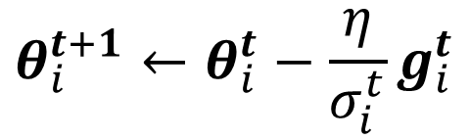
Learning Rate Scheduling
Learning Rate Decay:
As the training goes, we want to reduce the learning rate as we are close to the destination -> Precisely find the target position.
$${\text{η}}^{t}$$
$$θ_{i}^{t+1}←θ_{i}^{t}−\frac{\text{η}}{σ_{i}^{t}}g_{i}^{t}$$
$η$ is small as the training progress.
Without Learning Rate Decay
With Learning Rate Decay

Slide 14



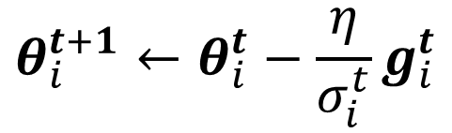

Learning Rate Scheduling
Increase and then decrease
Why Start with 0?
The estimate of $σ_{i}^{t}$ is not accurate at the beginning.
Choose a small learn rate to collect data near the initial position to better estimate $σ_{i}^{t}$.
When to decrease?
Hyper-parameter (you can tune).
Commonly-used in Transformer-based models.
BERT
Warm up
$${\text{η}}^{t}$$
$$t$$
$${\text{η}}^{t}$$
$$θ_{i}^{t+1}←θ_{i}^{t}−\frac{\text{η}}{σ_{i}^{t}}g_{i}^{t}$$

Slide 15
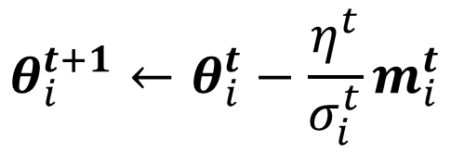

Summary of Optimization
(Vanilla) Gradient Descent
$$θ_{i}^{t+1}←θ_{i}^{t}−\text{η}g_{i}^{t}$$
Various Improvements
Learning rate scheduling
$$θ_{i}^{t+1}←θ_{i}^{t}−\frac{η^{t}}{σ_{i}^{t}}m_{i}^{t}$$
Momentum: weighted sum of the previous gradients
Consider direction (+/-)
root mean square of the gradients
only magnitude (square)
Notes:
Give an example about average v.s. absolute?

Slide 16
Classification

Slide 17

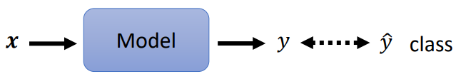
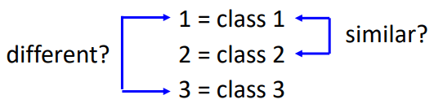

Classification v.s. Regression
Regression:
The model outputs a value given an input.
Example: predict Viewers of a YouTube Channel.
Classification:
The model classifies the given input into a class.
Example: classify an object in an image.
Can we treat classification the same as regression?
The model outputs 1 means class 1, outputs 2 means class 2…
A significant problem:
The distance between 1 and 2 is smaller than 1 to 3.
This will cause class 1 being similar to class 2 (but in fact, classes are independent).
$\hat{y}$ is the label data

Slide 18
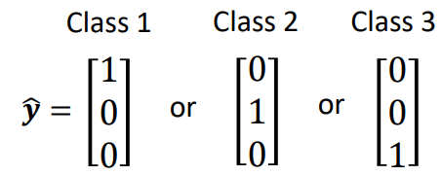
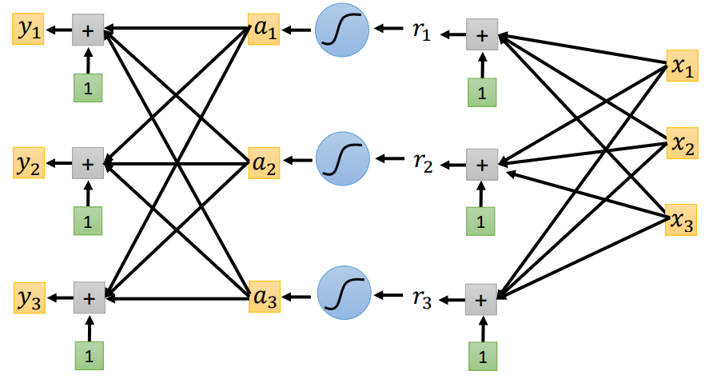
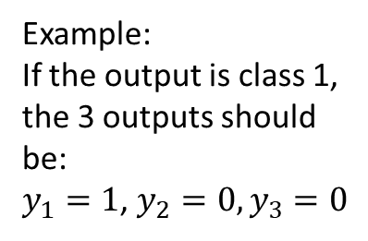
Class as One-Hot Vector
An alternative method to define classes is using one-hot vector:
So the distance between two classes is identical.
Now, the neural network needs to output 3 values (if the number of classes is 3):
Example:
If the output is class 1, the 3 outputs should be:
$y_{1}=1$, $y_{2}=0, y_{3}=0$

Slide 19
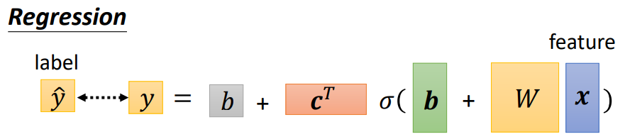
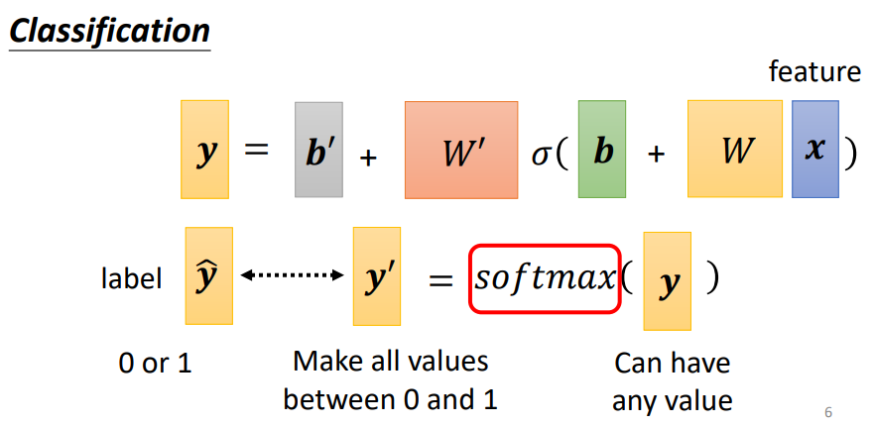
Softmax
In regression, the output is a scalar, which can be computed via:
In classification, the output is a value between 0 to 1.
We need to add a function called Softmax to make the output value between 0 and 1.

Slide 20








Soft-max
$$y_{i}^{′}=\frac{exp\left(y_{i}\right)}{\sum_{j}{exp\left(y_{i}\right)}}$$
$1>y_{i}^{′}>0$
$\sum_{i}{y_{i}^{′} =1}$
Softmax
0.88
3
20
$$y_{1}^{′}$$
$$y_{1}$$
0.12
2.7
1
$$y_{2}^{′}$$
$$y_{2}$$
≈0
-3
0.05
$$y_{3}^{′}$$
$$y_{3}$$
logit

Slide 21










Loss of Classification
$$L=\frac{1}{N}\sum_{n}{e_{n}}$$
label
Network
$$\hat{y}$$
$$y′$$
softmax
$$y$$
$$x$$
$$e$$
How to calculate $e?$
$$e=\sum_{i}{{\left({\hat{y}}_{i}−y_{i}^{′}\right)}^{2}}$$
Mean Square Error (MSE)
Cross-entropy
$$e=−\sum_{i}{{\hat{y}}_{i}lny_{i}^{′}}$$

Slide 22














-10 ~ 10
$$\left[\begin{aligned}1 \\ 0 \\ 0\end{aligned}\right]$$
$$y_{1}^{′}$$
$$y_{1}$$
-10 ~ 10
Network
$$y_{2}^{′}$$
softmax
$$y_{2}$$
$$x$$
$$e$$
$$y_{3}^{′}$$
-1000
$$y_{3}$$
large loss
Mean Square Error (MSE)
large loss
Cross-entropy
stuck!
$$y_{2}$$
$$y_{2}$$
small loss
small loss
$$y_{1}$$
$$y_{1}$$
Changing the loss function can change the difficulty of optimization.

Slide 23



Example
Consider a 4-class classification task where an image is classified as either a dog, cat, horse, or cheetah.
The neural network output (after SoftMax) is [0.775, 0.116, 0.039, 0.07]
Find the cross-entropy value if the correct class is dog, i.e., [1, 0, 0, 0].
Solution:
$\hat{y}=[1, 0, 0, 0]$ and $y^{′}=[0.775, 0.116, 0.039, 0.07]$
Thus $e=−\left(1×ln0.775+0×ln0.116+ …\right)=0.25$

Slide 24
A Colab Tutorial
https://pytorch.org/tutorials/beginner/blitz/cifar10_tutorial.html

